Slide 1
Municipal networks for mutual support - How can this contribute to the implementation of energy efficiency measures?
ENERDAY 30 September 2022
Uta Burghard, Markus Fritz, Fraunhofer ISI

Slide 2
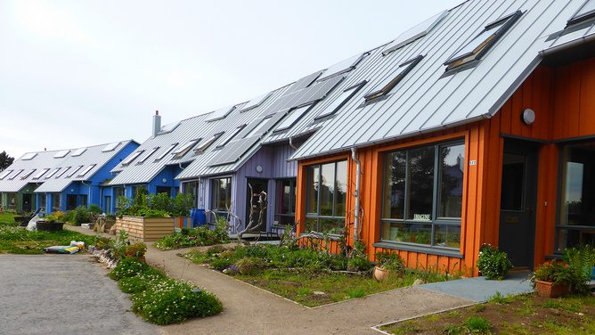
Municipalities play a crucial role in the transition to a low-carbon society
  Municipalities: Major contribution to greenhouse gas emissions (Strasser et al. 2018), dominant role of urban political actors in the transition process (Cheung and Oßenbrügge 2020), potential to change citizen‘s behaviour.
  Drivers of the energy transition: European, national and local climate goals and networks like the Covenant of Mayors.
  SEAP/SECAP (local)
  NECP/NEEAP (national)
  EU Commission
  However, municipalities face a lot of challenges, including a variety of topics, targets, stakeholders, and market dynamics (Strasser et al. 2018).
https://www.filmsforaction.org/
Notes:
Municipalities:
Major contribution to greenhouse gas emissions mainly through the energy consumption of buildings and transportation (Strasser et al. 2018)
Dominant role of urban political actors and decision makers in the transition process (Cheung and Oßenbrügge 2020).
Drivers of the energy transition: Covenant of Mayors (CoM): The EU Covenant of Mayors for Climate & Energy was launched in 2008 and brings together thousands of local governments voluntarily committed to implementing EU climate and energy objectives. www.covenantofmayors.eu
SEAP / SECAP: The Sustainable Energy and Climate Action Plan (SECAP) is the key document of a signatory of the Covenant of Mayor (CoM) since 2018. It is an extension of the former Sustainable Energy Action Plan (SEAP). These documents outline the key actions that Covenant signatories plan to reduce greenhouse gas emissions (GHG).

Slide 3

PATH2LC project brings together municipalities on regional and international level to support them in the process
  PATH2LC: Public Authorities together with a holistic network approach on the way to low-carbon municipalities
  Goal of the project: Support municipalities on regional and international level in the process of implementing their existing Sustainable Energy (and Climate) Action Plans (SEAPs / SECAPs).
  ‘Learning Municipality Network’ (LMN) approach: Link stakeholders in public authorities among municipalities enabling peer-to-peer learning and to increase the engagement for the energy and climate transition.
  www.path2lc.eu
  Project lifetime: September 2020 - August 2023
  H2020 project
Notes:
Core of the project: ‘Learning Municipality Network’ (LMN) approach: very close cooperation of municipalities in the form of regular, well organised and moderated meetings including expert input and peer-to-peer learning.

Slide 4
Five existing networks of municipalities in five countries
Italy (4 municipalities)
Greece (8 municipalities)
Netherlands (4 municipalities)
France (4 municipalities)
Portugal (9 municipalities)
Vesuv
Messini
Nazaré
Leeuwarden
Saone-Beaujolais
Notes:
in total 29 municipalities

Slide 5
One part of the scientific accompanying research is the technical monitoring
  Goal of the technical monitoring: Progress of each participating municipality, and the Learning Municipality Network as a whole. Asses impact of the LMN on the measure implementation.
  Procedure: annual survey (after 6, 12 and 24 months of the project):
  Monitoring of the implemented measures and the achieved energy and CO₂ savings.
  Determine the implementation status of the measures defined in the climate plans.
  Data collection: online questionnaire and Excel file, which was provided in the local language.
  Questionnaire was completed by representatives of each municipality participating in the networks.
  The measures implemented are recorded, including energy savings, increase in the share of renewable energy and reduction in CO₂ emissions.
  This presentation provides the results of the monitoring from 2021 & 2022.

Slide 6
Data base and monitoring results

Slide 7
351 measures represent the data base
Database: Measures from 22 municipalities were collected (in total: 29 municipalities).
In total: 351 energy-related measures (technical and non-technical measures).
Data quality:
297 (85%) without additional information on energy savings and 54 (15%) with additional information on energy savings.
259 (74%) without information on the energy carrier and 92 (26%) with information on the energy carrier.
162 (46%) measures without information on the year of implementation.
Measures included in SEAP/SECAP
Notes:
energy carrier: Gas, electricity or oil.
All municipalities in the project have a SE(C)AP.
Right side: Of the 351 measures, 258 measures are part of a SECAP and 44 measures are not part of a SECAP. No information was available for 49 measures.

Slide 8
A third of the measures have been fully implemented
Implementation status
Notes:
Left: Implementation status: Of the 351 measures, 116 measures have been fully implemented and 175 measures have been partially implemented or are still being implemented. No information was available for 60 measures.
Right: measures have been implemented continuously over the last few years. Especially since 2018, however, the number of implemented measures has increased.

Slide 9
There is a clear focus on transport, renewables and lighting measures
n=351 measures
Notes:
Category of measures:
Efficiency measures and renewables are often implemented.
There is a clear focus on transport, renewables and lighting.
Fewer measures were implemented in the area of heating and cooling, building retrofitting or social measures like stakeholder engagement.

Slide 10
Few measures can generate large energy savings
n=54 measures with information on savings
Notes:
It should be noted again, that energy savings were not indicated for all measures.
However, it can still be seen that especially a few measures in the area of renewables and heating and cooling can generate large savings.

Slide 11
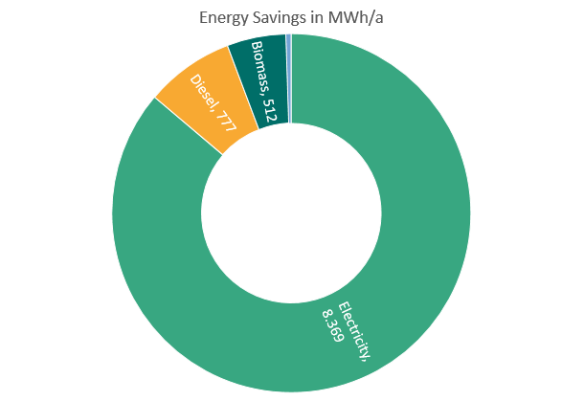
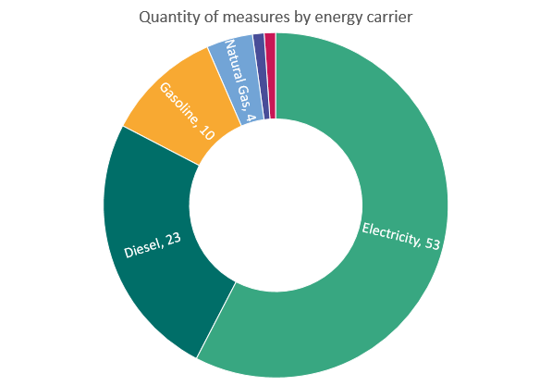
Most savings and most measures were implemented in the electricity and transport sectors
n=92 measures with information on energy carrier
n=54 measures with information on savings
Notes:
Most savings and also most measures were implemented in the electricity and transport sectors. This shows that there is still potential for further savings measures, especially in the area of heating and cooling.
Quantity = Anzahl sein. Also es gibt im Datensatz 53 Maßnahmen bei welchen Electricity als energy carrier angegebn wurde
Examples for measures:
Electricity = often ligthing or excahnge of inefficient appliances, e.g. compressors, (Kompressoren, Pumpen oder Kühlschränken.)
Diesel = procurement of electric vehicles
Natural Gas = Maßnahmen im Wärmesektor wie beispielsweise der Tausch eines Gas boilers

Slide 12
For around 20% of the measures funding was received
Notes:
Only 69 of the 301 measures received funding. For 230 measures it is not known whether a grant was received.
This shows that the topic of funding should be addressed more strongly in the municipalities in the future.

Slide 13
Discussion

Slide 14
Discussion
    Municipalities mostly implement measures from the SE(CA)Ps, but also pursue measures that are not part of a climate plan
    Climate plans can act as a driver for the transition, but not in every case.
    Municipalities focus on transport, renewables and lighting. Fewer measures were implemented in the area of heating and cooling, building retrofitting or social measures like stakeholder engagement.
    Focus so far on measures that seem to be easier to implement.
    Benefits of measures such as stakeholder engagement are more indirect and maybe not that obvious for municipalities.
    For social or non-technical measures, it is sometimes difficult to indicate savings, although these measures are often decisive for large savings.
    Only some of the measures received funding.
    Lack of knowledge or awareness in the municipalities regarding funding possibilities
Notes:
stakeholder engagement: refers to energy supplier or municipal council who are engaged to become active.
Genau definiert haben wir das nicht. Das war leider auch ein kleines Problem denke ich bei der Auswahl. Eigentlich war damit gemeint, beispielsweise Programme zu machen in welchen unterschiedliche Gruppen motiviert werden etwas zu tun. Beispielsweise der Gemeinderat oder Energieversorger oder so

Slide 15
Methodological discussion and outlook
    Methodological discussion: Challenges in obtaining data from municipalities -> data often incomplete.
    Possible reasons:
    Lack of financial and human resources in municipalities.
      Challenge to identify the person in the municipalities to complete the questionnaire.
      Responsibility within small municipalities in the field of climate and energy often not clearly assigned or distributed across different offices and departments.
    The selection of the categories of the measures is sometimes difficult and sometimes somewhat arbitrary. For future questionnaires, this selection should be simplified.
    Due to (still) limited data base the impact of the project can not yet be determined.
    Outlook:
    PATH2LC project raises awareness for the energy transition on a municipal level.
    Municipalities appreciate peer-to-peer learning as part of the LMN of PATH2LC.
    Impact of the project might be more obvious in the longer run.
Notes:
Lack of financial and human resources in municipalities. Municipalities could not get funded for participating in the project.
Challenge to identify the person in the municipalities to complete the questionnaire.
Responsibility within small municipalities in the field of climate and energy often not clearly assigned or distributed across different offices and departments. This is also a general challenge in the transition to a low-carbon municipality
The selection of the categories of the measures is sometimes difficult and sometimes somewhat arbitrary. For future questionnaires, this selection should be simplified and refer only to the 3-5 main categories.
Outlook:
PATH2LC project raises awareness for the energy transition on a municipal level and points to the responsibility of municipalities.
Municipalities appreciate peer-to-peer learning as part of the LMN; will be evaluated in more depth as part of the social-scientific evaluation.
Impact of the project might be more obvious in the longer run.

Slide 16
Thank you. Any questions?
  Uta Burghard
  Markus Fritz
  Fraunhofer Institute for Systems and Innovation Research ISI
uta.burghard@isi.fraunhofer.de
This research was funded by the European Union's Horizon 2020 research and innovation programme under grant agreement No. 892560.

Slide 17
Backup

Slide 18

Objectives and Procedure
Objectives
  Monitoring of the implemented measures and the achieved energy and CO₂ savings.
  Determine the implementation status of the measures.
  Provide evidence of the effects achieved by the measures.
  Method
  Annual online Survey
  OR entry in an Excel file

Slide 19
Structure of the questionaire
The questionnaire is available in all national languages.
It consists of a total of 4 pages.
The third page (Measures) is displayed in a loop as long as there are further measures for the entry.
Welcome page
General Information
Measures
Yes
Additional measures?
No
End

Slide 20

First page
On the first page there is an introduction text with information about the survey and the privacy terms and conditions.

Slide 21
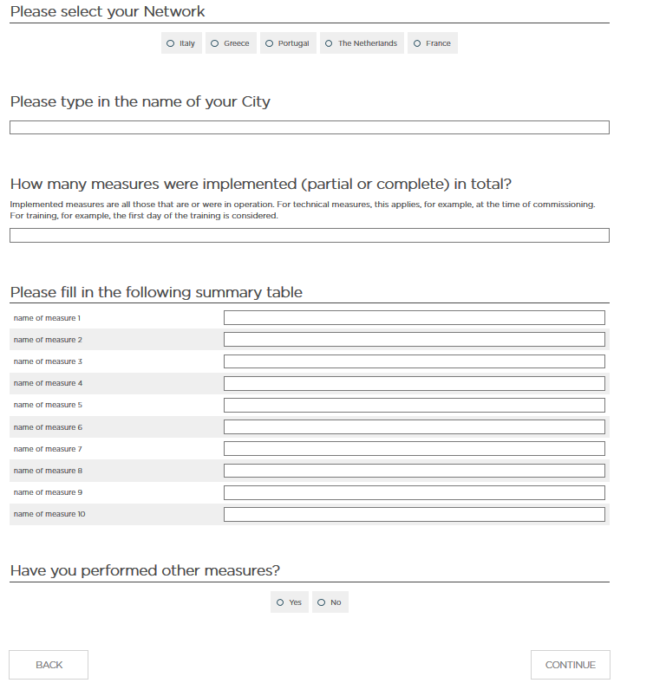
Second Page
On the second page, general information about the municipality is requested.
The network and the name of the city are requested.
In addition, the total number of measures, as well as the respective names of the measures are requested.

Slide 22
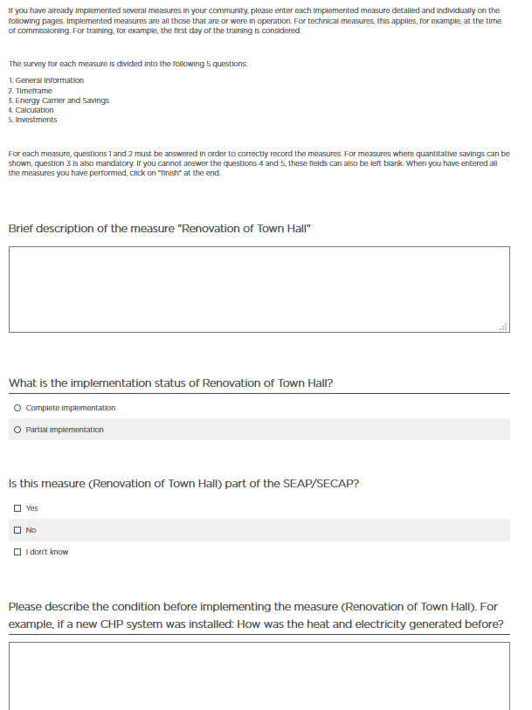
Third Page
The third page is a loop and appear for every measure.
More detailed information about the measures is requested.
Pre-selections are provided for all categories to ensure consistency.
Some questions are mandatory, others voluntary.

Slide 23
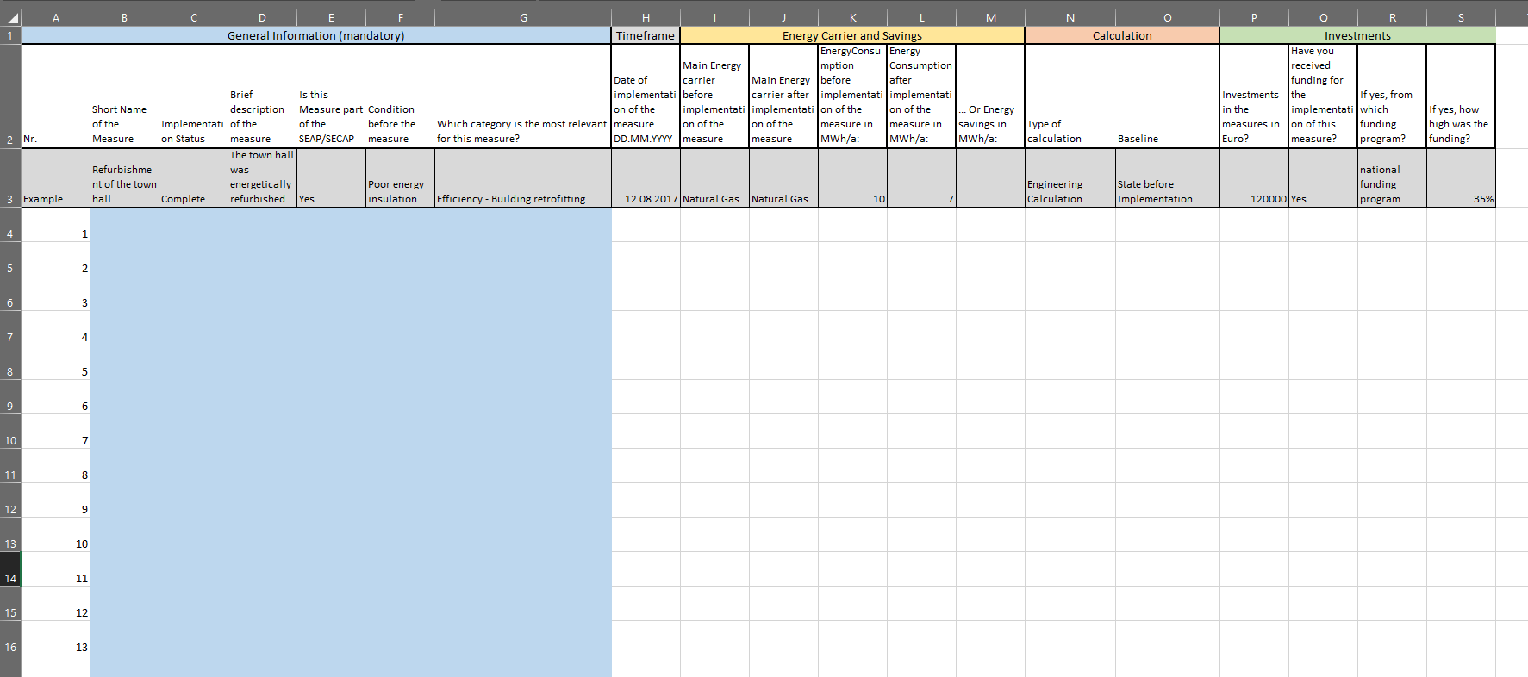
Excel File
To help with the input and to simplify the data entry Fraunhofer ISI provided an additional Excel help file.
This file can be used to collect the necessary information in advance.
It contains the same questions and answer options as the online survey.

Slide 24
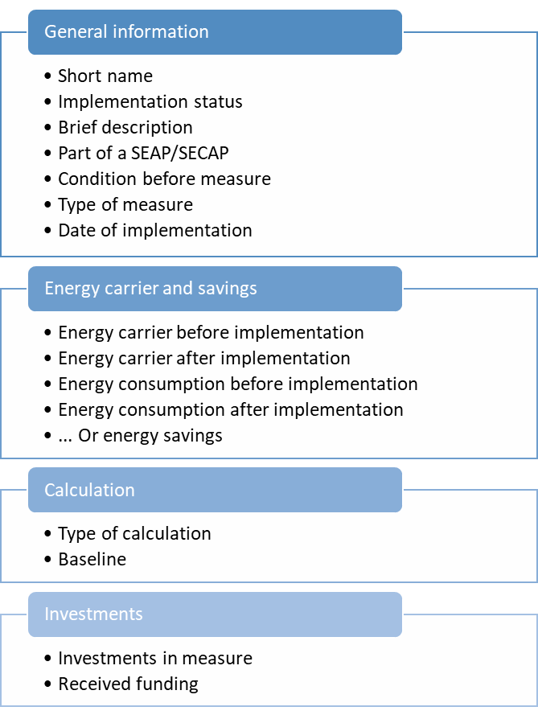
Detailed information on Measures
The detailed information is divided into 4 sections.
On the following slides each section is presented individually.

Slide 25
General Information
The entry of the general information is mandatory.
This information is used to assign the measures to the different categories in order to find out in which sectors the greatest savings have been achieved.
It also asks whether the measures are part of a SEAP/SECAP.

Slide 26
Energy Carrier and Savings
The main energy carrier and the energy consumption are requested before and after the implementation of the measures. From this, the energy savings and, by specifying the energy carrier, also the CO2 savings can be calculated.
As an alternative to the energy consumptions, the savings can also be specified.
The information requested here is voluntary.

Slide 27
Calculation
It is requested how the savings were calculated and what the baseline is for determining the savings.
This is important to be able to compare the savings of the individual measures.
The information requested here is voluntary.

Slide 28
Investments
It is asked how high the investment for the measure was.
The savings can then be used to determine the funding efficiency of the individual measures. The funding efficiency means how much money has to be invested for the savings of one kWh.
In addition, it is asked whether there have been any subsidies for the implementation of the measures.
The information requested here is voluntary.

Slide 29
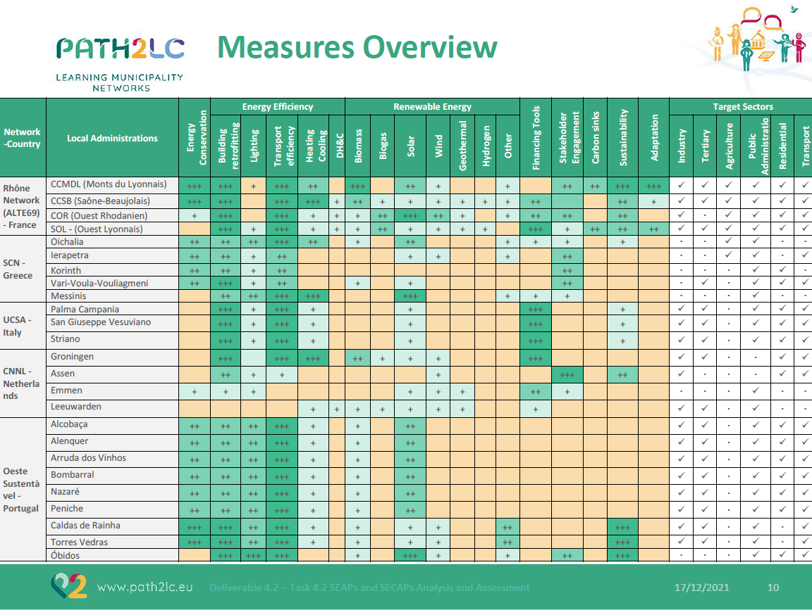

Slide 30
Financial efficiency
Only 33 measures with indication of savings and investments
The median savings in this sample are 239 MWh/a and the median investments are 60,000€
The average financial efficiency (avoidance cost) in this sample is 0.45 €/kWh
This is comparatively high to average avoidance costs in buildings or industry which are on average between 0.01 and 0.03 €/kWh. (https://deep.eefig.eu/)

